Slide 1
Meowtion
FIRMWARE
#HACKTHEKITTY 2026
Notes:
The collar’s firmware has 4 jobs

Slide 2
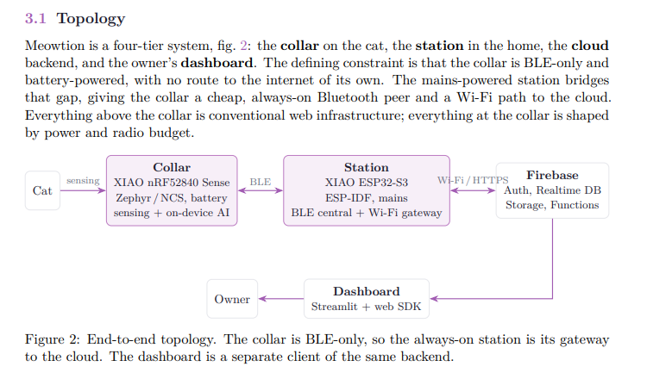
Meowtion
#HACKTHEKITTY 2026
Notes:
1 Run the rules based activity gate: while the cat is active sample to the IMU and run the classifier cascade, on sustained stillness drop to low power rest until motion returns

Slide 3
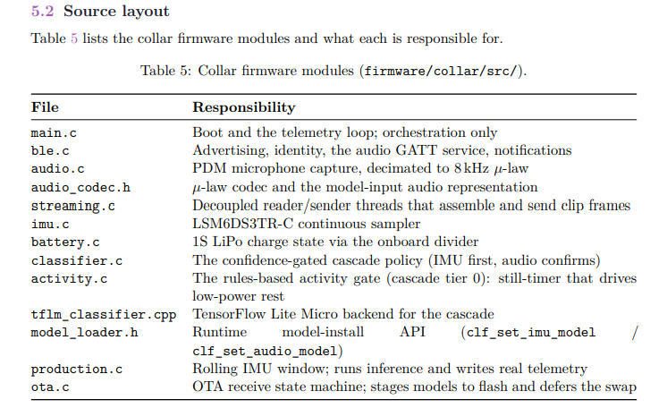
Meowtion
#HACKTHEKITTY 2026
Notes:
2 advertise the result as an 8 byte BLE telemetry packet for the station to read

Slide 4
Meowtion
#HACKTHEKITTY 2026
Notes:
3 in training mode, stream paired audio and IMU frames to a subscribed station for capture

Slide 5
Meowtion
#HACKTHEKITTY 2026
Notes:
4 receive new models over the air and swap them in safely

Slide 6
Meowtion
#HACKTHEKITTY 2026
Notes:
The station’s firmware is a BLE central that hears registered collars and a wifi gateway that relays them to the owners firebase account

Slide 7
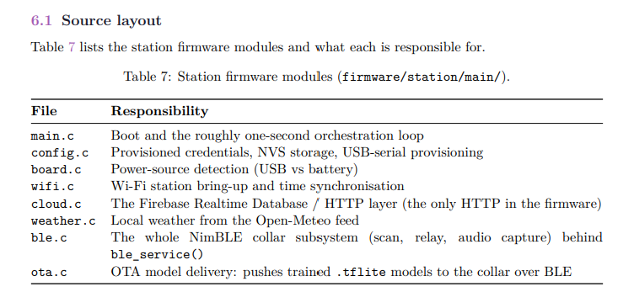
Meowtion
#HACKTHEKITTY 2026
Notes:
it also captures short audio and IMU training clips and uploads them and delivers trained models to the collar over BLE

